Slide 1
SIR Executive(s?)
Arthur LeBlanc

Slide 2
SIR model
Susceptible
Able to be infected
Infectious
Able to infect
Recovered
R0
Rate of disease expansion
Effects to reduce R0
https://towardsdatascience.com/infectious-disease-modelling-beyond-the-basic-sir-model-216369c584c4

Slide 3
Common Diseases
Influenza
R0 between 0.9 and 2.1
~0.1-0.13% death rate
1 day before and 5-7 days after sickness
COVID
R0 between 3.28-5.7
Can spread with no symptoms
Severe sickness rate of ~20%
Death rate depending on age, but averaging
1.8% per observed case
Assuming 20% severe sickness, 9% death rate to severe sickness (1.8%/20%)
Current infected population ~50/100,000
Coburn BJ; Wagner BG; Blower S (2009). doi:10.1186/1741-7015-7-30
https://www.cdc.gov/flu/about/disease/spread.htm
https://www.goodrx.com/blog/flu-vs-coronavirus-mortality-and-death-rates-by-year/
"Novel Corona virus - Information for Clinicians" Australian Government - Department of Health. July 6, 2020.
https://coronavirus.jhu.edu/data/mortality
https://www.nytimes.com/interactive/2020/us/georgia-coronavirus-cases.html

Slide 4
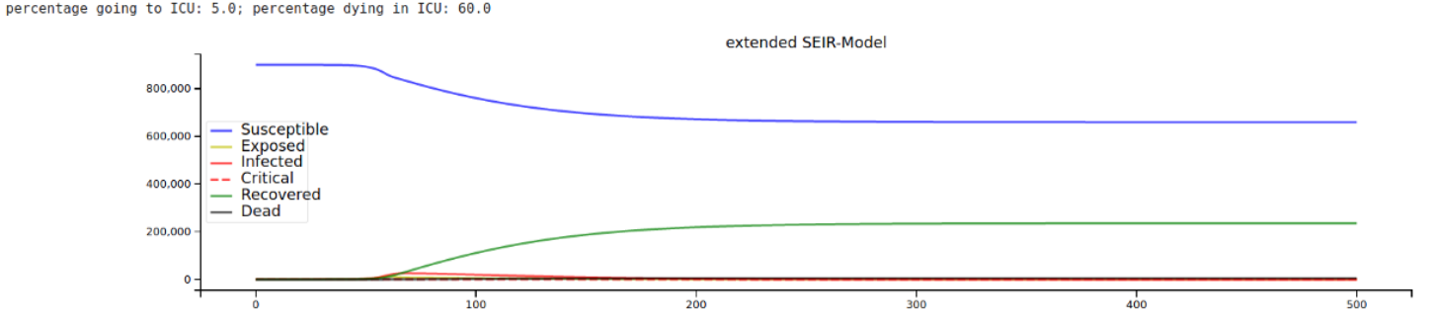
Other models
Direct math model to explain spreading
Differential equations over time with access to important parameters
Equipment capacities
Beds
Oxygen
Details involving changing rates
Ideal for infinite expansion
Some allow direct visualizations to explore the effects of partial or complete adherence to
Masks
Distancing
https://towardsdatascience.com/infectious-disease-modelling-fit-your-model-to-coronavirus-data-2568e672dbc7
https://ncase.me/covid-19/

Slide 5
My Simulation model
Infection length
Default of 4 days
Possibility of sickness
Assumes sickness is out of commission
Can die during sickness
If recovered, will go through cycle time after being finished
Once recovered, will not reinfect
List of parameters
Attempt at –random state
Number of executives
Number of Agents
Percent initially infected
Percent sick from infected
Percent deaths from sick
R0
Rate is over one whole cycle
Being sick effectively doubles
Rate per day is R0/length
Percent vaccinated
Simulation time
Simplistic agent concentration

Slide 6
Improvements on Project 2
Structure
Death rate
Vaccination state
Dictionary
Allows removal for lower time completion of removing agents
Multiple cities
Possible other capabilities

Slide 7
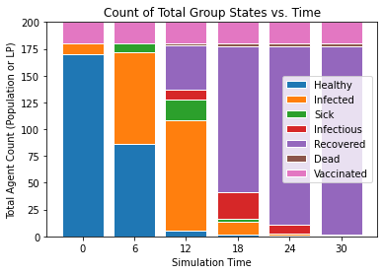
Best Use Case
Many current drawbacks to model
Vaccination exploration
At what percent vaccination is there a severe reduction to the spread
Remaining healthy population at simulation end
Right shows stacked bar chart of the viable states to the population
Parameters:
-r 42 -x 2 -s 30 -switch 0.00 -p 100 -dsick 0.2 -dinfected 0.05 -dr0 5 -ddead 0.1 -dvacc 0.1

Slide 8
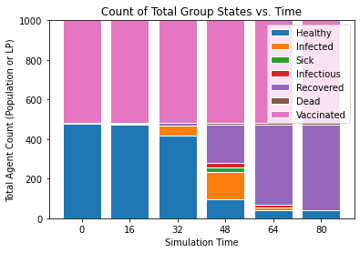
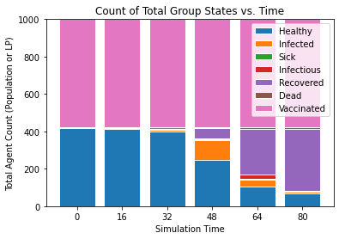
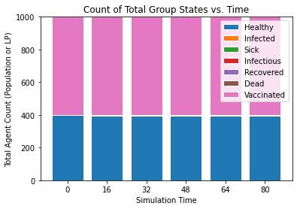
Vaccination Effectiveness
Parameters:
-r 62 -x 1 -s 80 -switch 0.00 -p 1000 -dsick 0.2 -dinfected 0.0005 -dr0 5 -ddead 0.1 -dvacc 0.52
Parameters:
-r 62 -x 1 -s 80 -switch 0.00 -p 1000 -dsick 0.2 -dinfected 0.0005 -dr0 5 -ddead 0.1 -dvacc 0.58
Parameters:
-r 62 -x 1 -s 80 -switch 0.00 -p 1000 -dsick 0.2 -dinfected 0.0005 -dr0 5 -ddead 0.1 -dvacc 0.6
Start seeing some large changes of 1000 agents at around 50%-60% vaccinated

